Slide 1
SSDs and SSD practical issues
Welcome to our presentation
Creator: Vũ Hoàng Hiệp
Phan Sơn

Slide 2
Why we choose SSD ??
HDD
Noisy
Slow operation
Slow access
SSD
???
???
???
This is the solution
Nút like

Slide 3
Development and history
1978
Late 1980
StorageTek
(company), STC 4305 (1st model)
Zitel
(Inc.)
DRAM

Slide 4
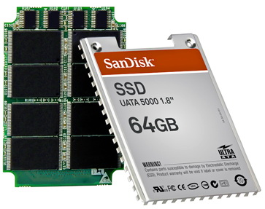
So, what is SSD ???
SSD ( Solid-State Drive):
A solid-state storage device.
Use integrated circuit assemblies as memory to store data persistently.
Do not have physical disks.
Use flash memory to store user’s data.

Slide 5
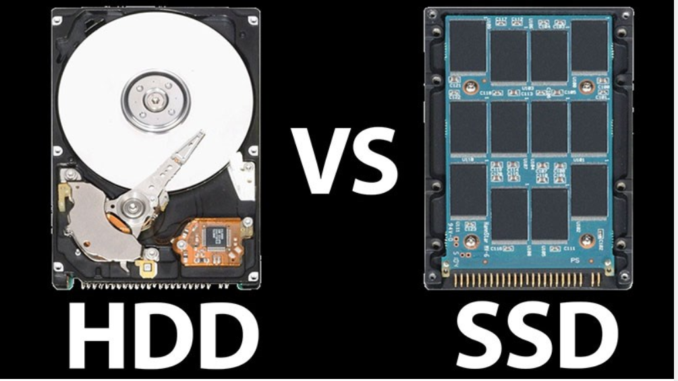
Storage: use Disk Memory to store data in the disk’s surface.
Speed: Slower
Frag: Yes
Reliability: less
Noise: yes
Appearance: not appreciated
Storage: use Flash Memory to store data in flash’s chips even without electric.
Speed: faster
Frag: no
Reliability: more
Noise: almost no
Appearance: highly appreciated

Slide 6
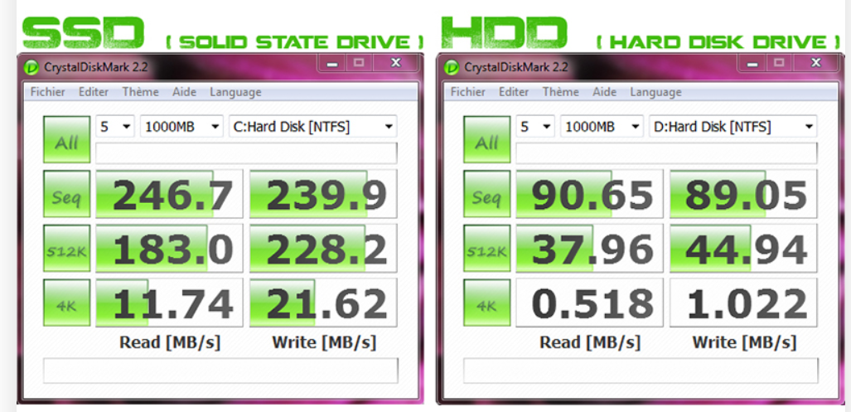
About the Speed
- SSD save data in Flash chip

Slide 7

About the Frag
SDD do not use disk so it won’t frag and the final quality will not be affected

Slide 8

About reliability
SSD do not use mechanical mechanism so it could keep the data safety from external forces
HDD usually be damaged if the impact is too strong

Slide 9
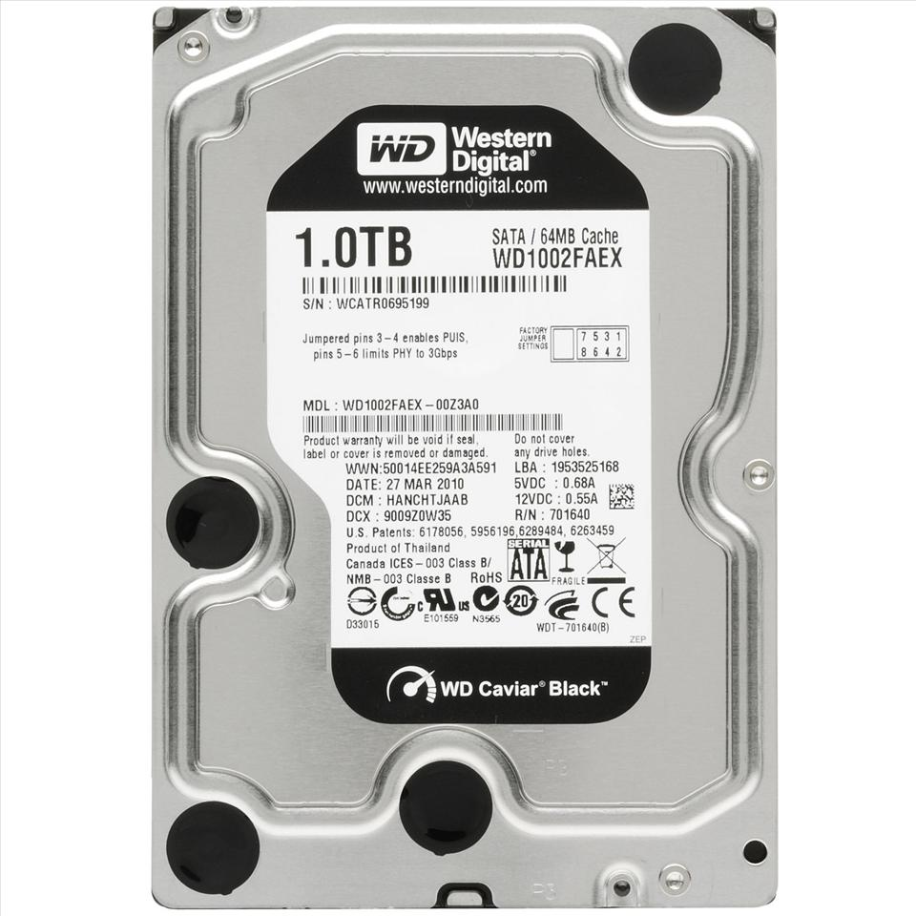
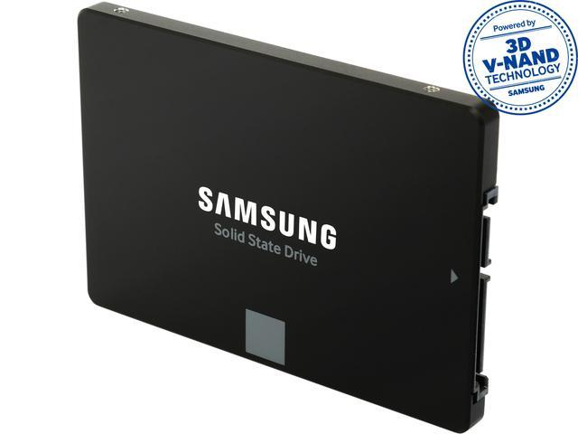
Appearance
SAMSUNG 850 EVO 2.5” 250GB SATA III 3D NAND SSD
HDD WB 1T 2.5” SATA 7200 RED
SSDs are highly appreciated in terms of form as well as much more flexible in design

Slide 10

Noise
HDD drive will be quite vibration and noise when saving / accessing data
the SSD works extremely smoothly and smoothly.

Slide 11
DEFECT
Expensive
Extracting data can be an extremely difficult and lengthy process.
Quite expensive for data recovery
Data could be lost and cannot be recovered
Data will be inaccessible if controller chip, cache or one of NAND memory chips is physically damaged

Slide 12
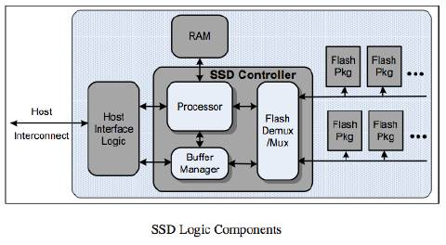

Slide 13

How it works in total
SSDs can only write to a blank page in a block
How does SSD handle data deletion?
How does SSD handle data writing?

